Slide 1

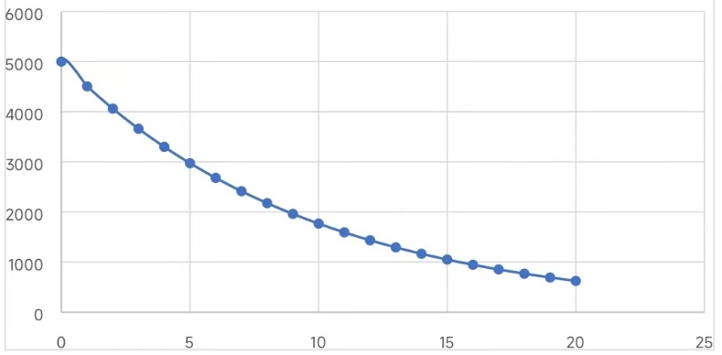
Solutions of question 1
C23 Group 1
Bowen WEI, Jianing WANG, Changyu LI, Ang LI
Introduction
The question is about the exponential function V (t) = 5000(2)^{−0.15t}, which keeps decreasing in the real number field. This question is focused on calculating the value of the sensor. We will figure out the value at year 0, 5, and 10 and graph it. This question can help us to have a more clear acknowledgement of exponential function.
Response to Questions
(a)The question is talking about the original value of the sensor. And the value of the sensor can be described by the function above. So the original value mains when the t is equal to zero, the value of the function is the original value.
t=0 V(t)=5000*(2)⁰=5000 The key way to solute the question is by finding the starting point of the function.
(b)When t is equal to 5, it shows that the value of the sensor 5 years later.
So the value of the sensor is V(t)=5000*(2)^{-0.75}=2973.02
The key way to solute the question is by putting the date into the function.
(c)When t is equal to 10， it shows that the value
of the sensor 10 years later. So the value of the
sensor is V(t)=5000*(2)^{-1.5} =1767.77
(d) As shown in the figure.
Conclusion
The question is talking about the original value of the sensor. And the value of the sensor can be described by the function above. So the original value mains when the t is equal to zero. We can figure out how the value change by its graph. The function is about how to describe a kind of graph. It gave us a new method to solve this kind of problem. Especially in economy and physics.

